Slide 1


Fixing TCP Slow Start for Slow Fat Links
Maryam Ataei Kachooei
Pinhan Zhao
Mark Claypool
Feng Li
Jae Chung

Slide 2





Introduction – Satellites
Geo Satellites provide global networking
  Remote locations
  On airplanes
  During natural disasters
  Bitrates increasing (20x recently)
150 ms
150 ms
Challenge is latency
  About 600 ms round trip
Latency impacts TCP bitrates
TCP connection

Slide 3
Introduction – TCP
TCP sends one window of data each RTT
Window starts small, doubles each RTT during slow start
TCP limits the size of the windows to the smallest of these three windows
Sender window
Congestion window
Receiver window
Data
Data
Data
Data
Data
Data
Data
ACK
ACK
ACK
ACK
ACK
ACK
ACK

Slide 4
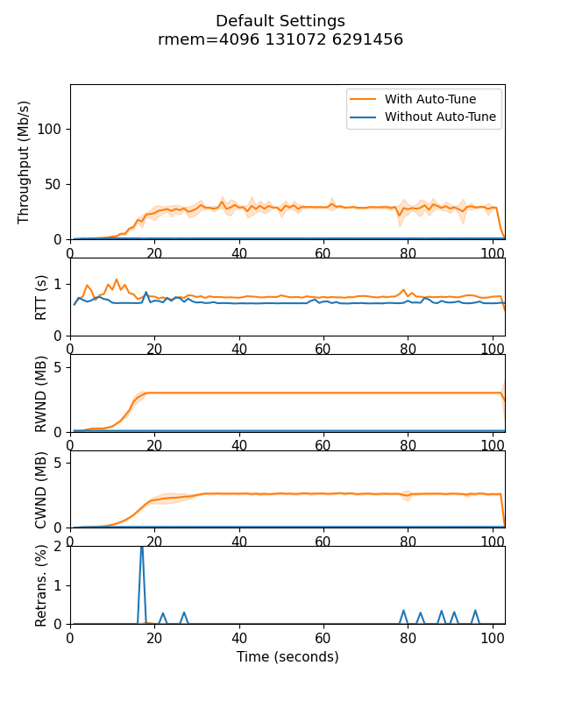
Buffer Sizes Limit Performance
Capacity 144 Mb/s
Linux Defaults
  Auto-Tune enabled
  rmem = 4 KB, 128 KB, 6 MB
  wmem = 4 KB, 16 KB, 4 MB
Bitrate below link capacity, limited by Linux buffer setting
Benjamin Peters, Pinhan Zhao, Jae Won Chung, Mark Claypool. TCP HyStart Performance over a Satellite Network, In Proceedings of 0x15 NetDev, July 2021.

Slide 5
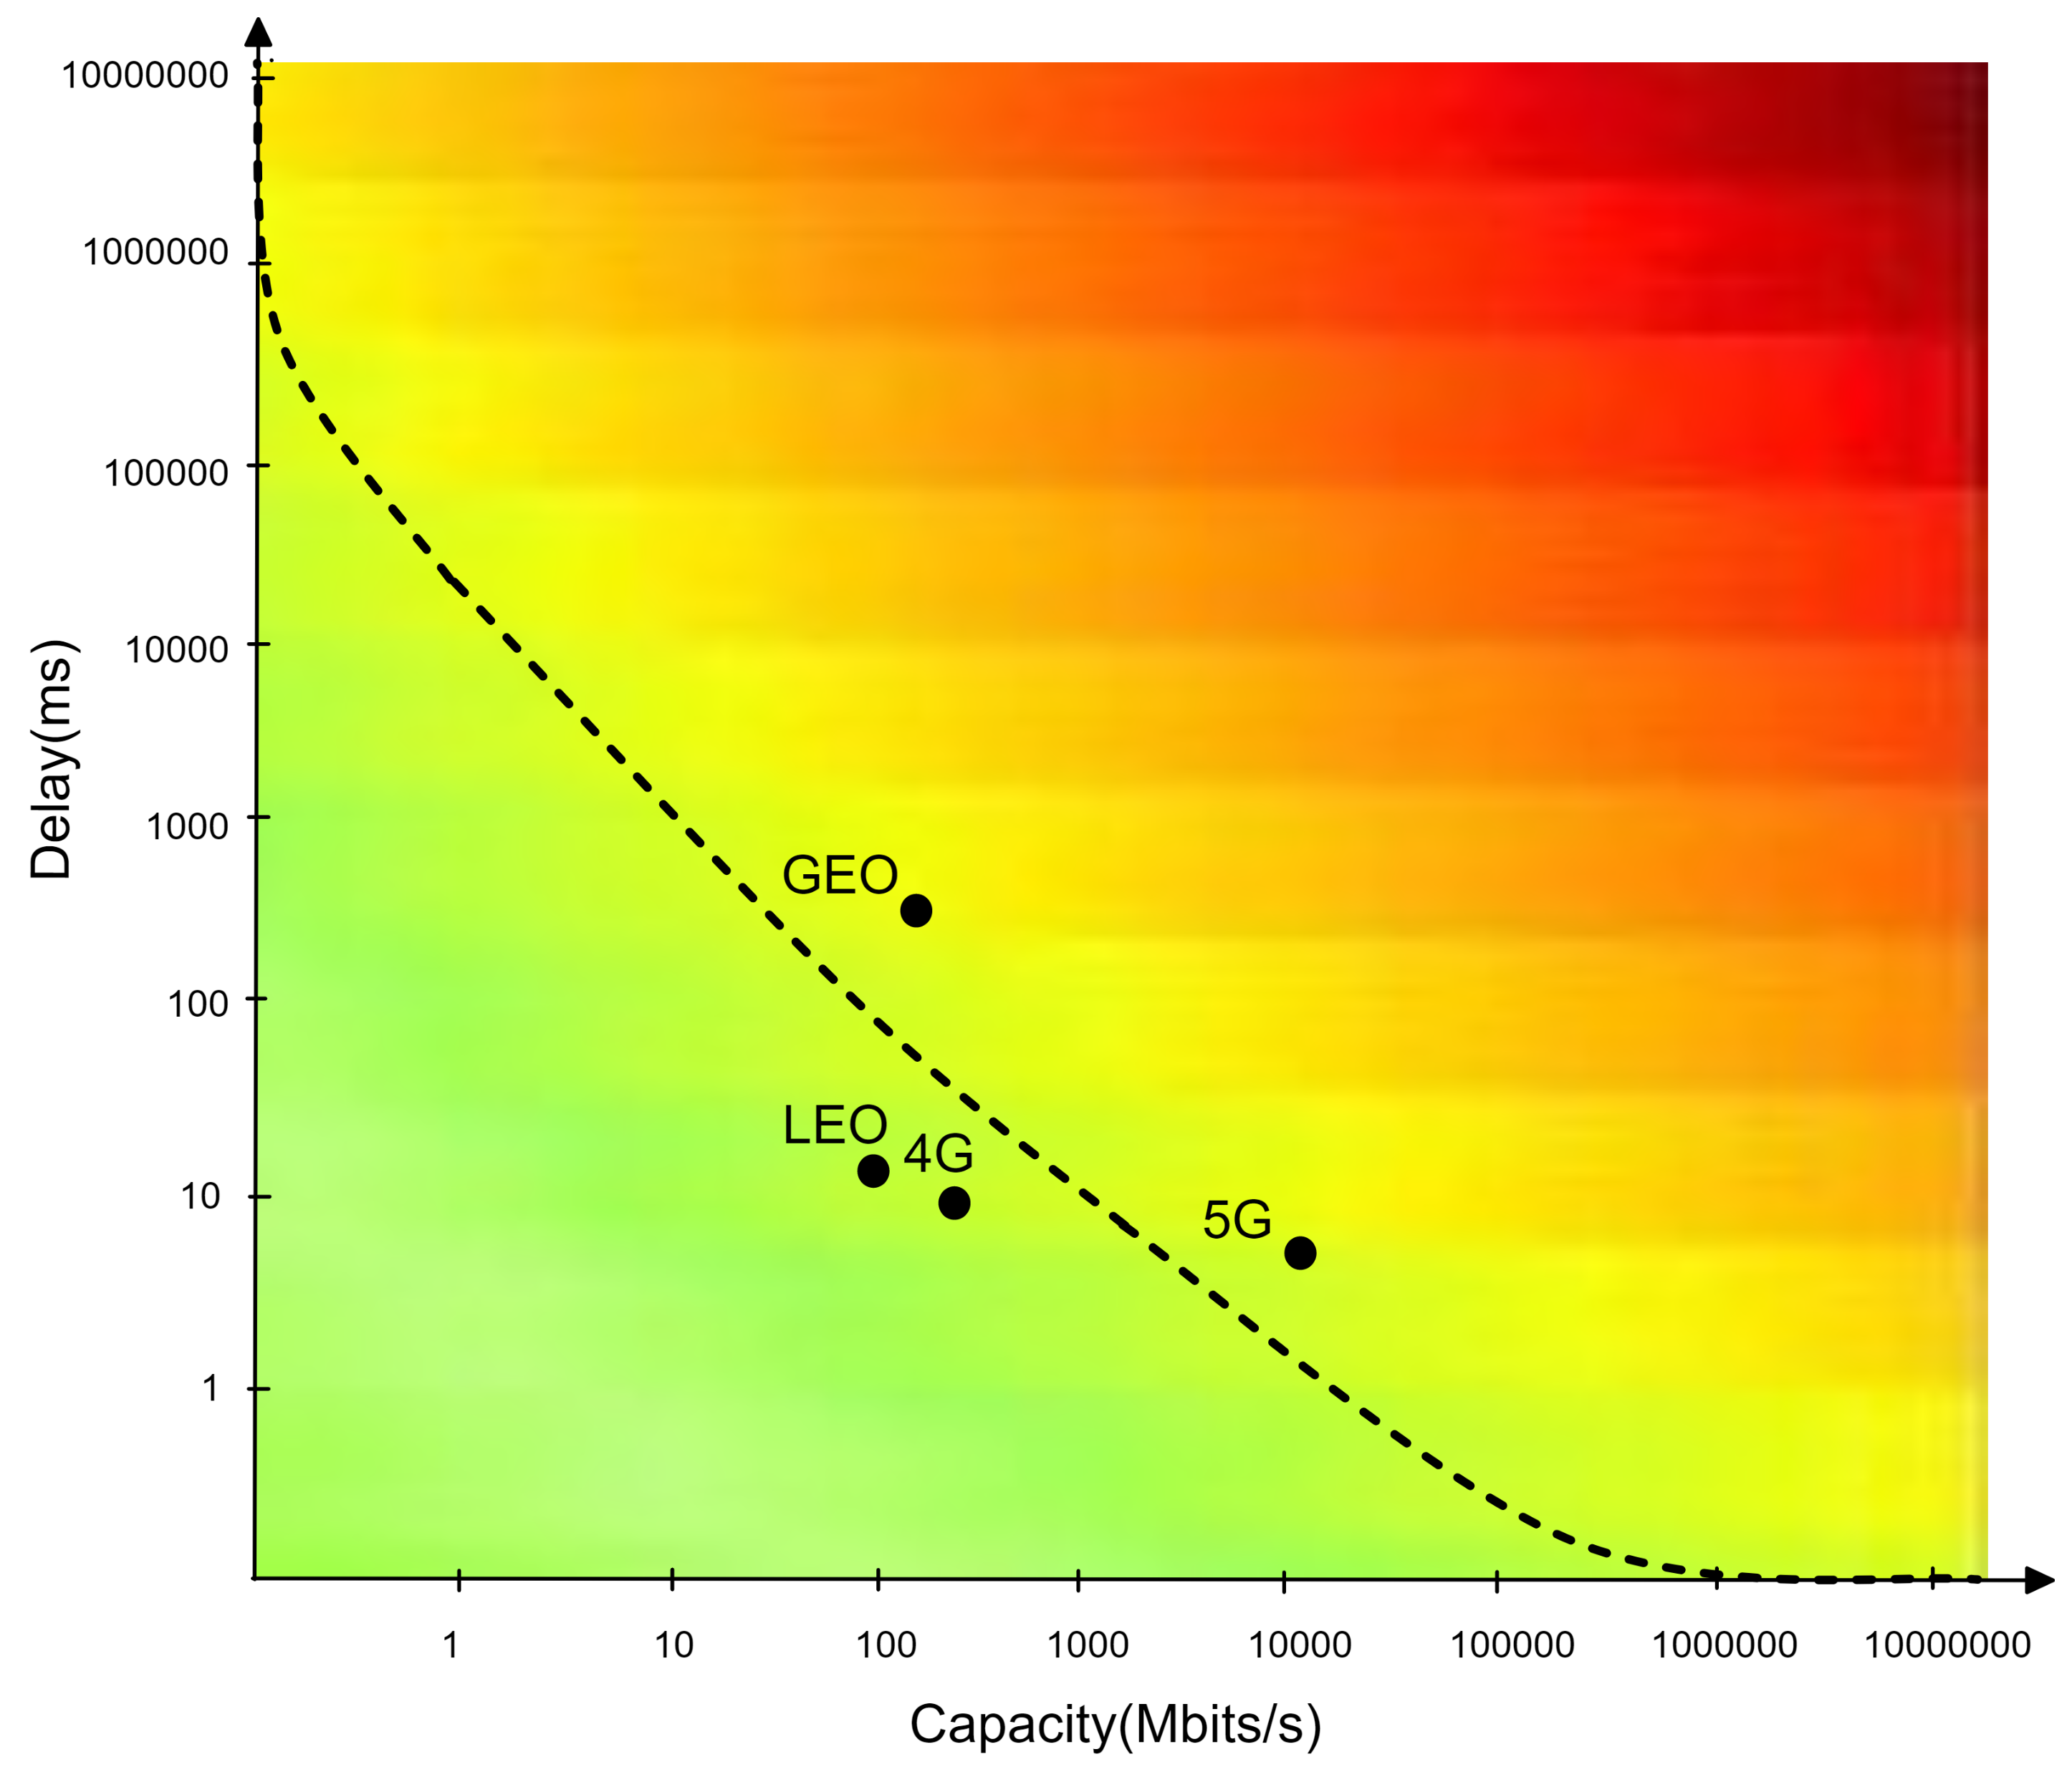
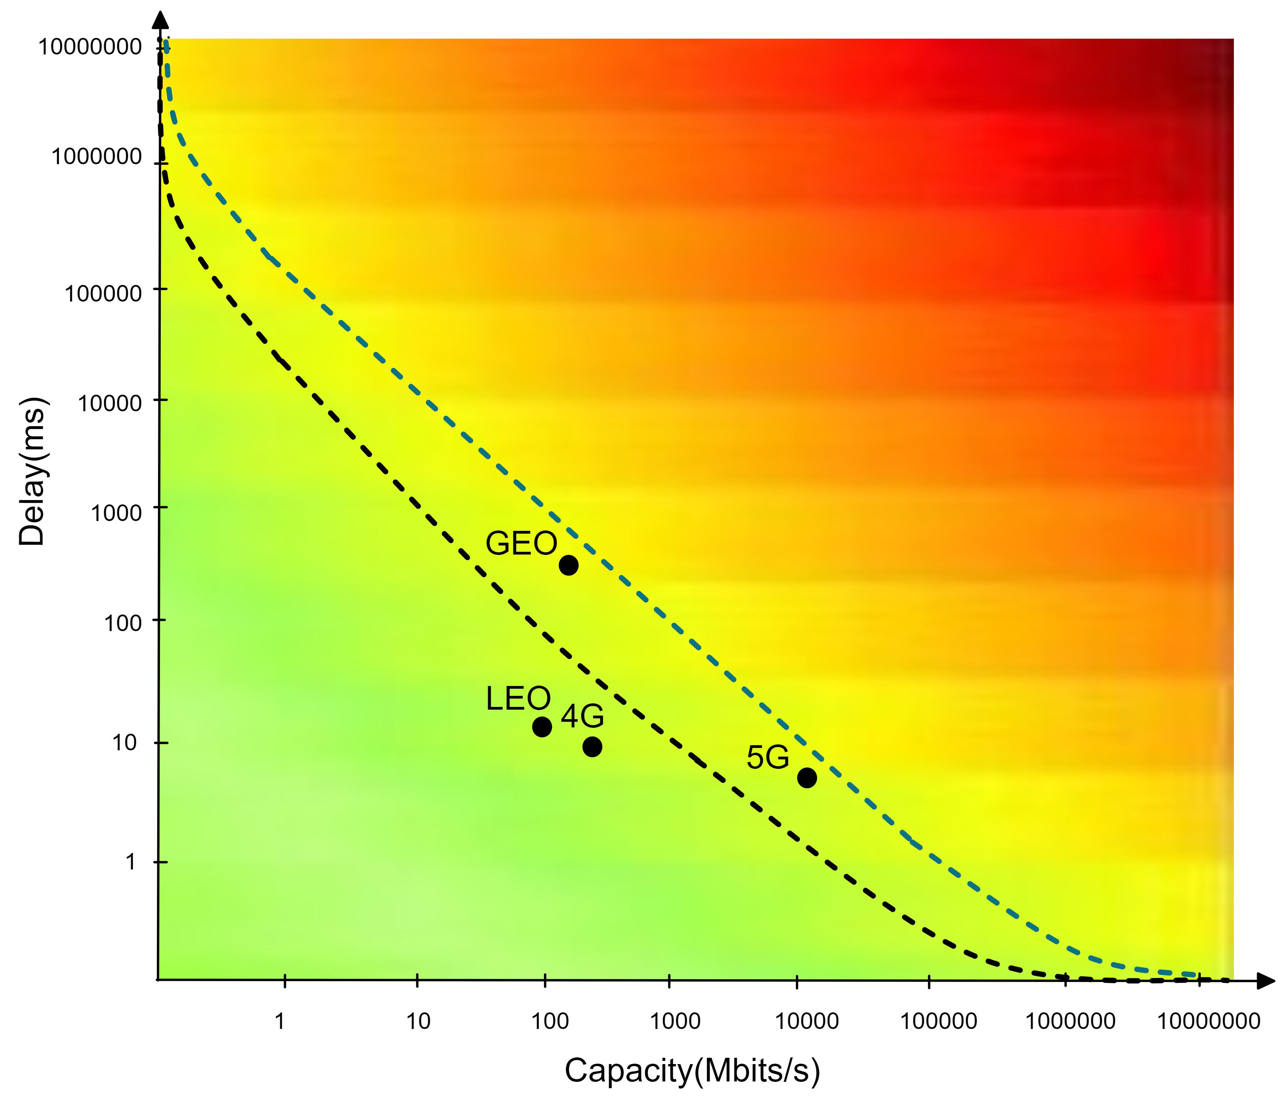

Buffer Sizes Limit Performance
Link | Delay (ms) | Capacity (Mb/s)
GEO | 600 | 150
LEO | 30 | 100
5G | 10 | 3000
4G | 20 | 200
Recommended
Default
Receiver buffer (tcp_rmem)
  Default: 4096 131072 6291456
  Recommended: 4096 131072 26214400
Sender buffer (tcp_wmem)
  Default: 4096 16384 4194304
  Recommended:4096 16384 26214400
Benjamin Peters, Pinhan Zhao, Jae Won Chung, Mark Claypool. TCP HyStart Performance over a Satellite Network, In Proceedings of 0x15 NetDev, July 2021.

Slide 6
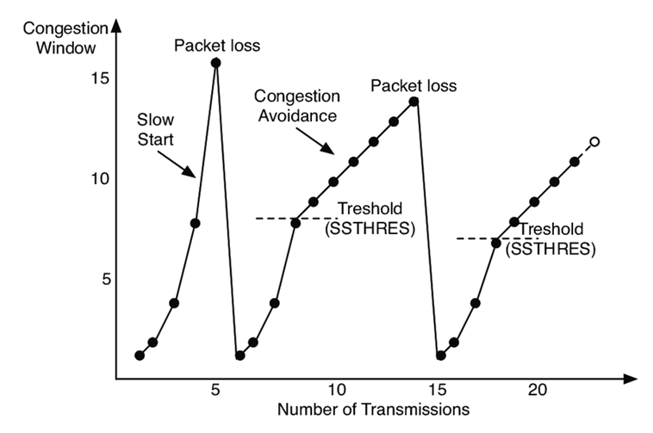
TCP Slow Start – Revisited
Hystart is designed to exit TCP slow start before packet loss to avoid overshooting link throughput
Hystart is on as Linux default
When Hystart works well, it exits slow start before loss to avoid overshooting
When Hystart does not work well, it exits slow start prematurely
Can we avoid this?
Exit closer to here?
So, how well does Hystart work for a Geo Satellite link?

Slide 7
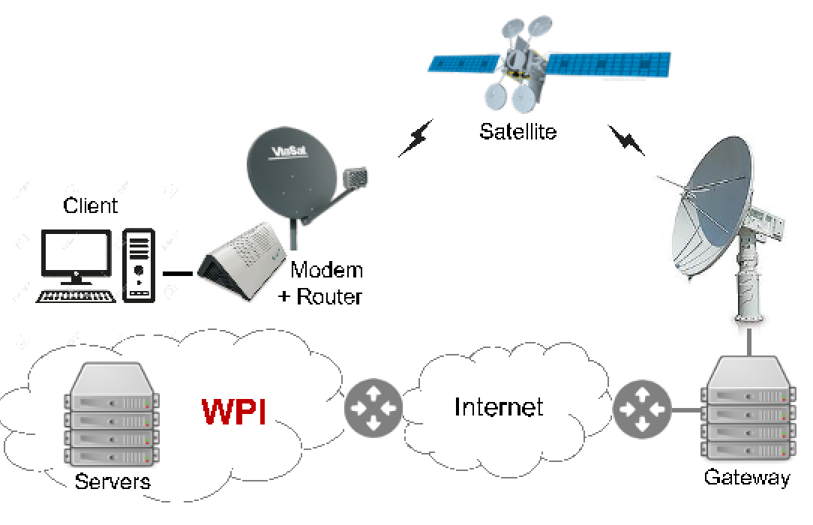


Methodology
Viasat testbed
  High RTT
  Consistent capacity with single satellite
  Transient uplink scheduling may impact ACK timing
LEO testbed
Variable Link Capacity
  Sensitive to the weather
Asymmetric Links
  Downlink bitrate is higher than uplink bitrate
Transient uplink scheduling and handover may impact ACK timing
Bulk downloads: Hystart On, Hystart Off
Measurements taken at the sender (e.g., throughput)
150 Mb/s
100 Mb/s

Slide 8
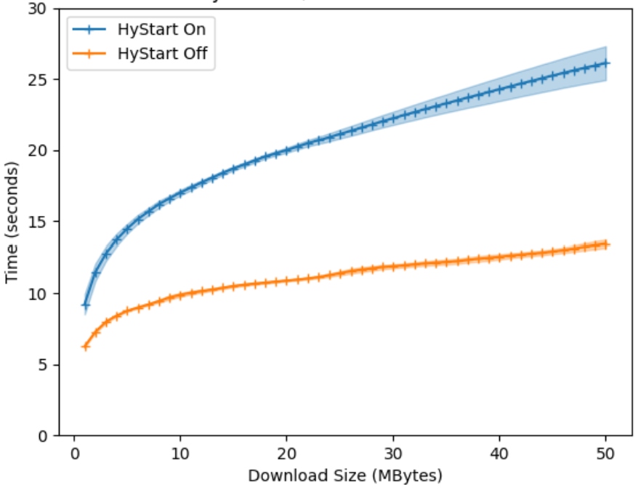
Download Times
1 MB downloads take 50% longer with HyStart
Average website (5 MB) takes 2x longer with HyStart
Why doesn’t HyStart help for Geo Satellite link?

Slide 9
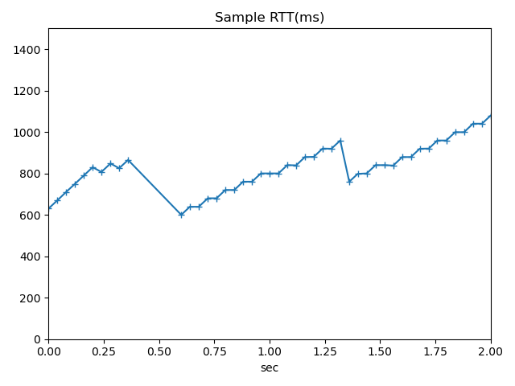
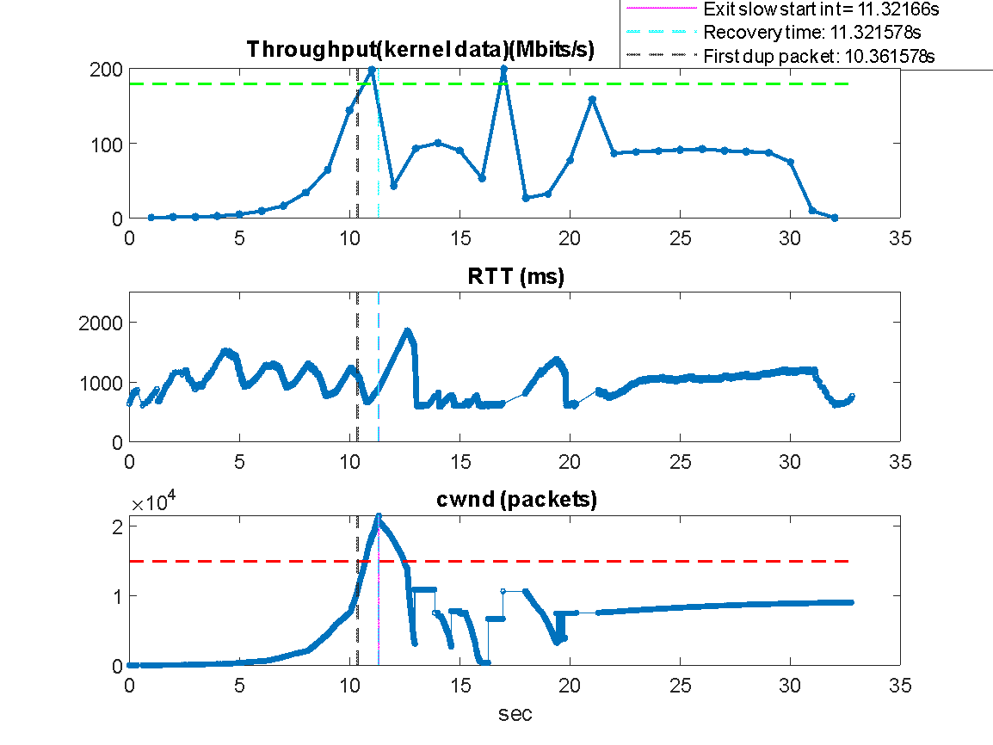
TCP Round-trip Times
RTT increase but download is not saturating link
  TCP Acks need channel grant
  Channel estimates adapt slower than TCP’s doubling
Finding exit condition by delay only difficult!

Slide 10
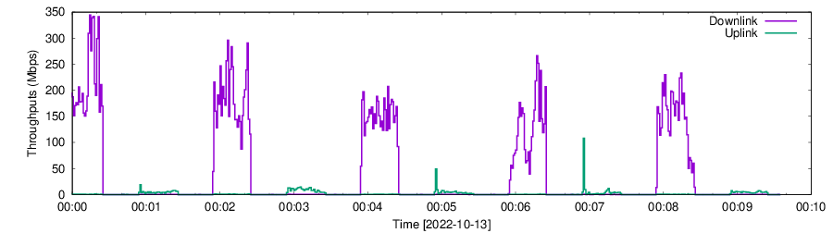
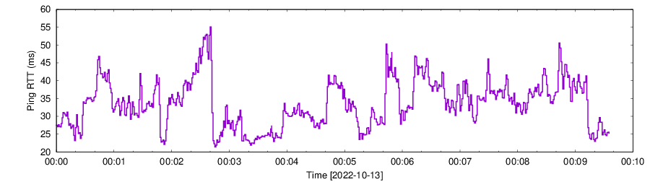
Example of download over LEO link
RTT varies a lot
Throughput varies a lot
Delay still is a problem over LEO link!
Notes:
Throughput varies RTT varies …..

Slide 11
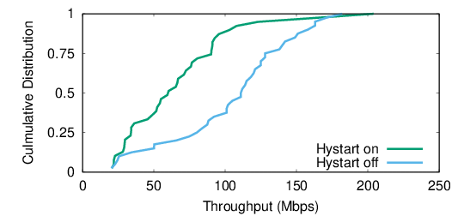
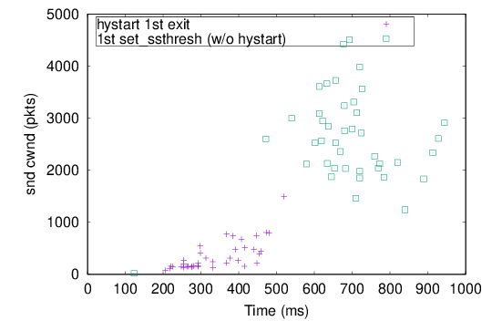
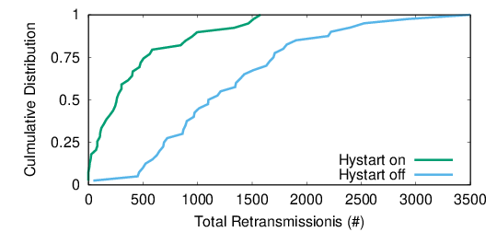
Hystart Exits too Early over LEO Link
Hystart exits too early, when cwnd is still small.
When Hystart off, the cwnd is much bigger when loss happens (first time call set_ssthresh()).
Throughput
Cumulative Distribution
Hystart is ineffective for LEO and GEO
Retransmission
Cumulative Distribution
Total Retransmission

Slide 12
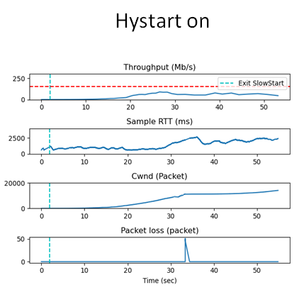
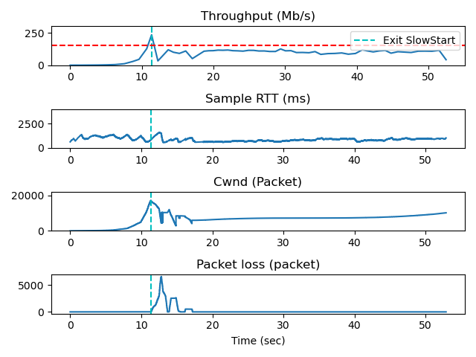
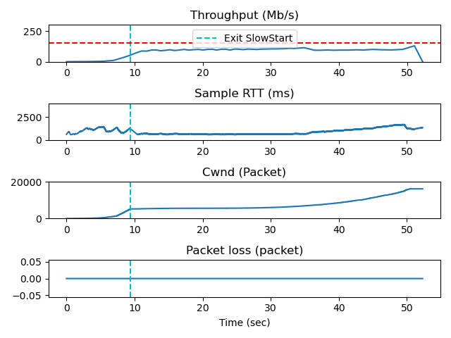
Results for different Exit point over GEO link
Hystart off
Exit in optimal point
Exit too early
Exit too late
When should exit?
Need to find the optimal Exit point

Slide 13
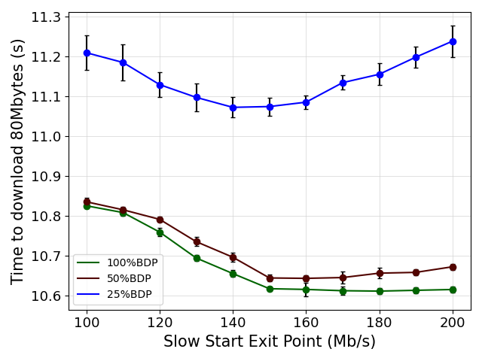
Optimal exit point with different queue sizes
Too early
Too late
Size ratio (%) | Queue size (Mb)
100 | 11
50 | 5.5
25 | 2.75
Small router queues make exit point decision even more important

Slide 14
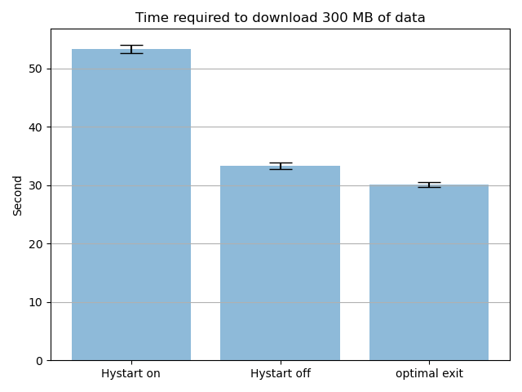

Example of download over GEO link
Exit at better point
Deciding on exit point based on bandwidth estimation

Slide 15
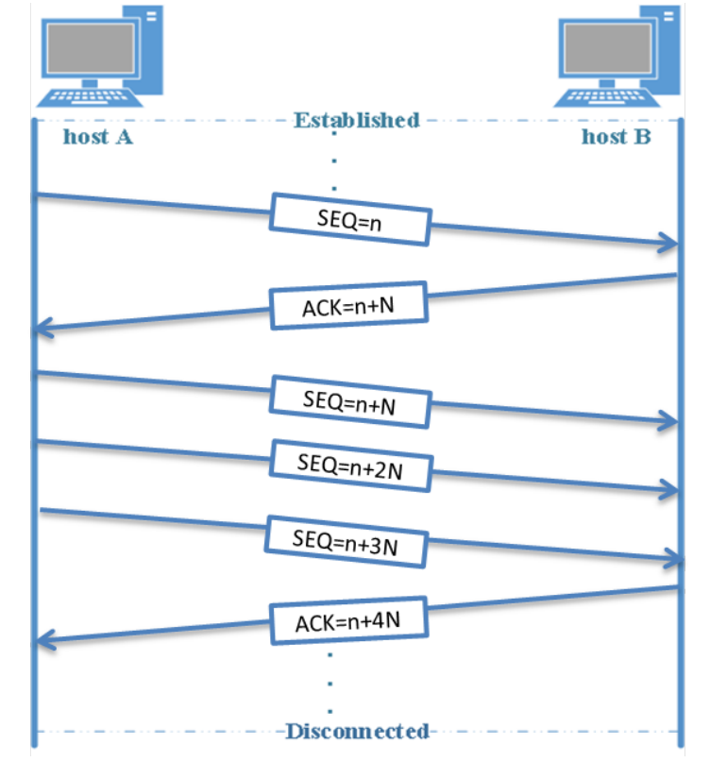
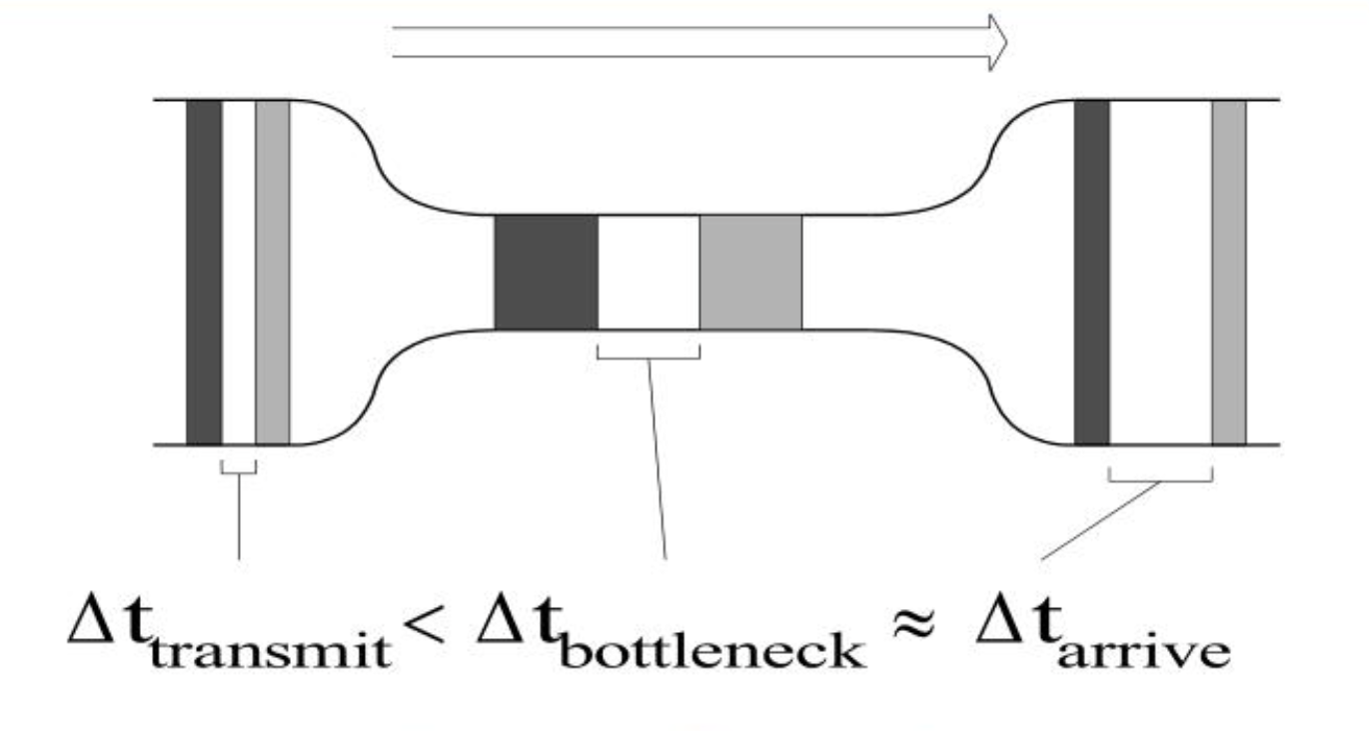
Approach
How to do at server?
  → Use ack-pairs
Use packet-pairs to estimate bandwidth
ack-pair Δt
bytes acked
bandwidth = packet size / Δt
bandwidth = bytes acked / ack-pair Δt

Slide 16
bictcp_acked_function()
/*this function call for every ack*/
curr_time = now
diff_time = curr_time – prev_time
curr_bytes_acked = tp->bytes_acked
diff_bytes_acked = curr_bytes_acked – prev_bytes_acked
bandwidth_estimate = diff_bytes_acked / diff_time
prev_bytes_acked = curr_bytes_acked
prev_time = curr_time
Sender
Receiver
prev_bytes_acked
prev_time
prev_bytes_acked
diff_time
Curr_bytes_acked
prev_time
curr_time

Slide 17
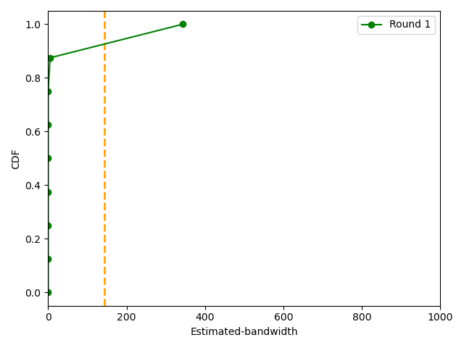
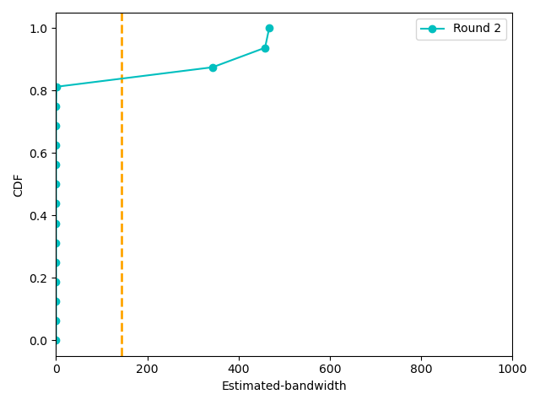
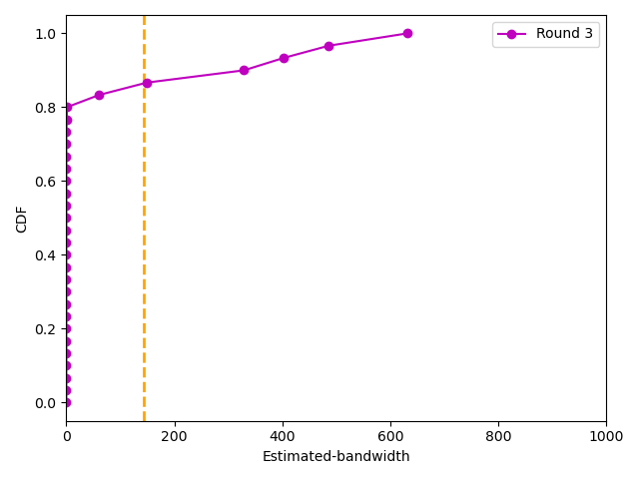
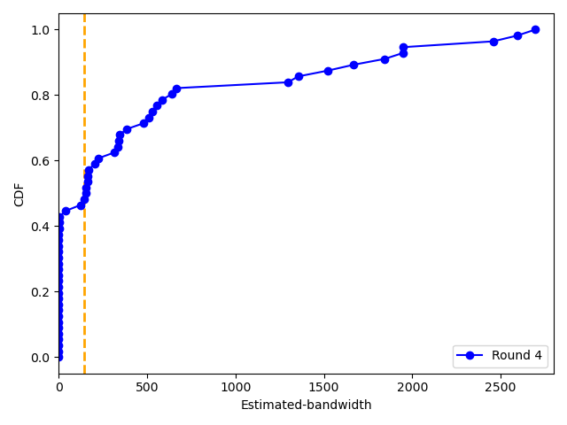
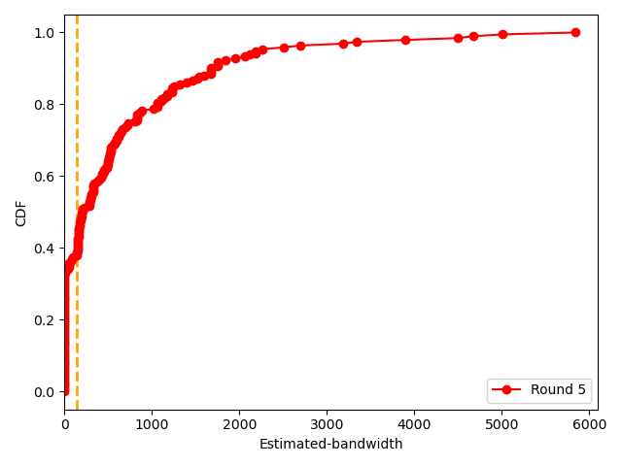
Bandwidth Estimates over Geo Sat Link
Round 1
Round 2
Round 3
Round 4
Round 5

Slide 18
bictcp_acked_function()
insert bandwidth_estimate to bw_est [] array
when RTT round ends:
median_est = median of bw_est[]
if median_est > 0:
ssthresh = median_est x RTT
else
clear bw_est [] //for the next RTT
Bandwidth Estimated Slow StarT (BEST)
estimated bandwidth
set ssthresh = median(bw_est[]) * RTT

Slide 19
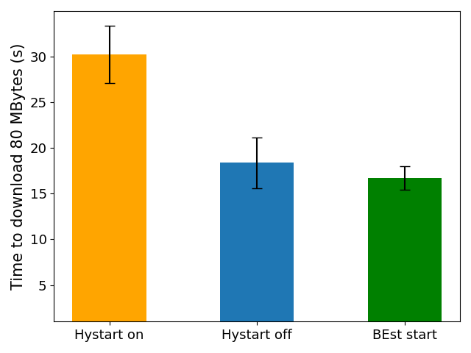
Results over Geo link
Hystart on : Exit prematurely
  High download time
Hystart off : Exit too late
  Lower download time
BEST : Exit at the better point
  Lowest download time
Hystart on
Hystart off
BEST

Slide 20
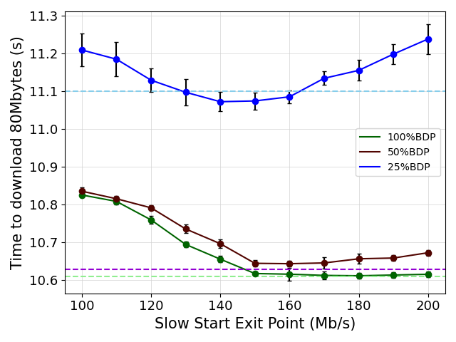
Results over Geo link
25% BDP-BEST
50% BDP-BEST
100% BDP-BEST
BEST algorithm is near the optimal Exit point for different queue sizes

Slide 21
Conclusion
Slow fat links need larger sender and receiver buffer sizes in Linux than default
  GEO links and 5G links under utilized
Slow fat links challenging since getting right TCP window size critical
  Exit too early: under utilization, Exit too late: packet loss
  TCP Hystart exits too early for LEO link and GEO link
BEST uses packet pair bandwidth estimation to set ssthresh
  Performs better than Hystart over GEO link
GitHub link: https://github.com/maryam-ataei/tcp_bw

Slide 22

Ongoing Work
Accommodate LEO link characteristic
Parameters for current heuristic
  Number rounds, percentage of distribution
Median from limited space
  Memory optimization
  Running median vs. “true” median
Filtering out extremely low or extremely high estimations
  Identifying and removing extreme values before making an estimate
  May need to have special consideration for data centers
Evaluation in more networks
  More network + system configuration

Slide 23
Fixing TCP Slow Start for Slow Fat Links
Thank-you for your attention!
Maryam Ataei Kachooei
Pinhan Zhao
Mark Claypool
Feng Li
Jae Chung

Slide 24
Appendix

Slide 25
Algorithm
Every ack:
bw_est = bytes_acked / Δt
insert (bw_est, bw_est_array)
At end of an RTT round:
bw_est = median (bw_est_array)
if median is greater than 0
set ssthresh = bw_est x RTT
else
clear bw_est_array

Slide 26
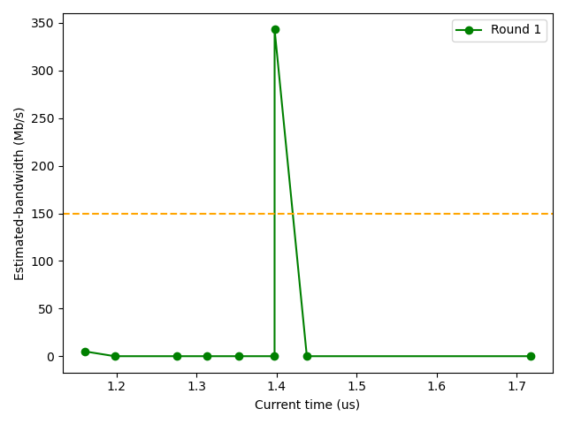
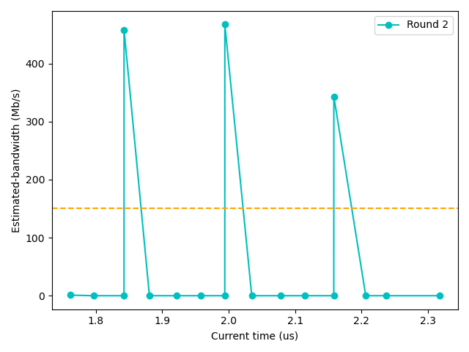
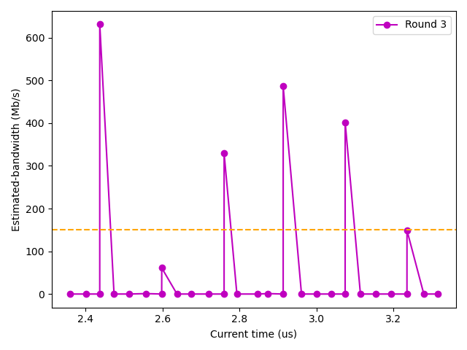
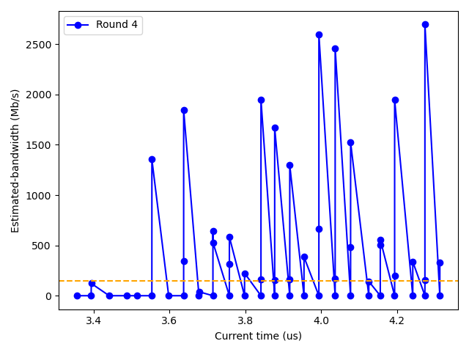
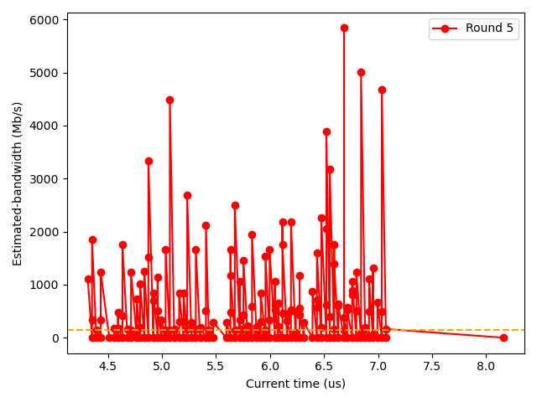
Bandwidth Estimates over Geo Sat Link
Round 1
Round 2
Round 3
Round 4
Round 5

